Slide 1
Button Mash Master

Slide 2
Group Members
Jasper Phua
Tan Kin Lek
Ivan Leong
Muhammad Shafik bin Mazlinan

Slide 3
What is Button Mash Master?
Button Mash Master comprises of playing through a wide variety of competitive minigames.
It has simple game controls which comprises of the left, up and right buttons.
Each minigame explains its rules & controls before playing commences.

Slide 4
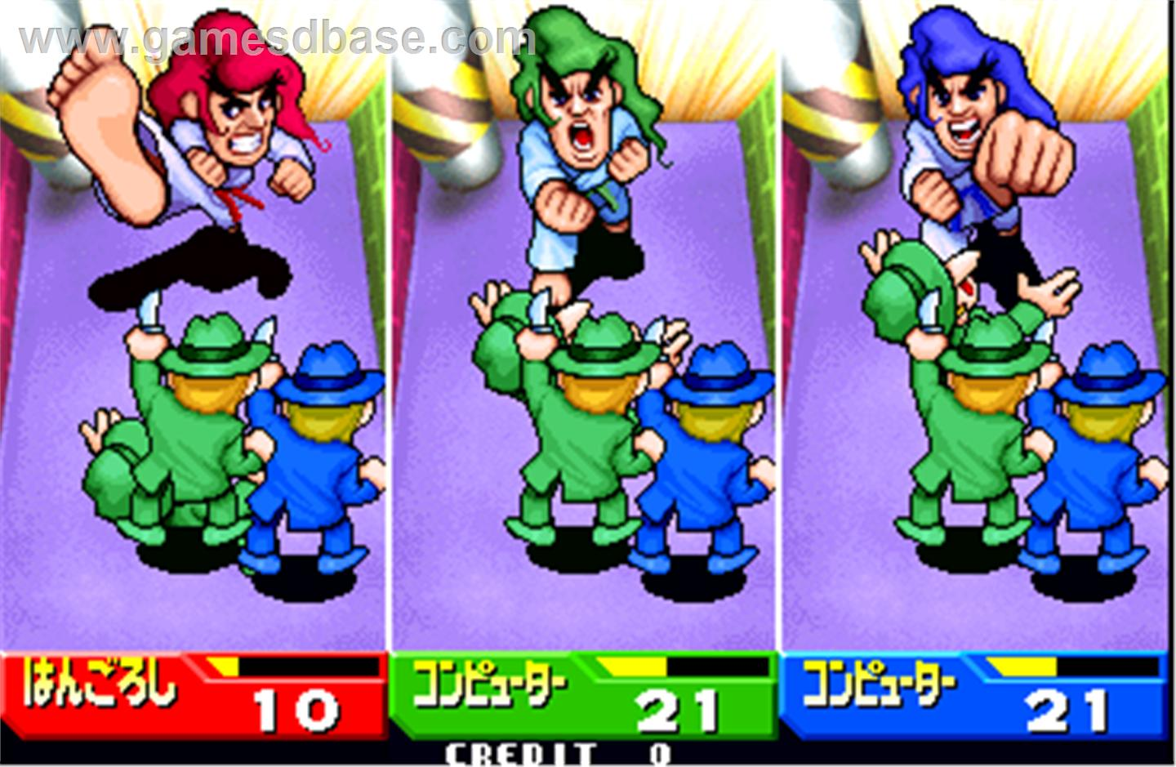
Inspirations for the game
Bishi-Bashi

Slide 5
Features
Normal mode/Random mode
Ranks for each minigame
High-Score System
Sprite animations loaded from txt file
Unique Game Controls

Slide 6
Any questions?

Slide 7
Thank you for listening!

